Slide 1
Hardening your development process
SOFTWARE QUALITY CONFERENCE
PACIFIC NW
NICOLÁS GUINI (MCAFEE) OCTOBER 8, 2018
PNSQC ™
Notes:
Every day, we can find new software security issues, exploits and new ways to misuse the software to do things never thought. Security criminals look every day at the software we produce and try to find a simple breach to exploit it and gain control to use it as they wish.
Many times, the security tests are not considered because it is difficult to see results, it is difficult to implement, or it costs time and money. But, when attackers find security flaws in our software, we regret the decisions made previously and we wish to have checked again with a security perspective.
For these reasons, it is important to add controls and security checks in our development process. The application of the Secure Development Process (SDL) added to a Security Maturity Model (SMM) helps our development teams find security infractions in the early stages before the software comes out into the open.
The purpose of this paper is to review an introduction to the life cycle of secure development and how it can be improved by verifying it with a measure of the security maturity model. We discuss how this process helps to find security problems in a new feature development. And a practical application of lessons learned to make this process faster and easier for development teams.

Slide 2
WHOAMI
From Cordoba, ARGENTINA! ☺
System Engineer and Information Security Specialist.
Certified in Ethical Hacking (CPHE and CHEE certs) from Spain.
Software Engineer and Security Software Architect at McAfee Argentina Software Development Center.
Leads the local Security Research team on Malware Analysis and Binary Exploitation.
Virus Lab Owner.
Local conferences and universities speaker.

Slide 3
Key points and Overview of Content
SOFTWARE QUALITY CONFERENCE
PACIFIC NW
SDLC Introduction
PSMM
Concept
Requirements
Design
Implementation
Verification
Release
Response
Conclusions
PNSQC ™

Slide 4
Key points and Overview of Content
SOFTWARE QUALITY CONFERENCE
PACIFIC NW
SDLC Introduction
PSMM
Concept
Requirements
Design
Implementation
Verification
Release
Response
Conclusions
PNSQC ™

Slide 5
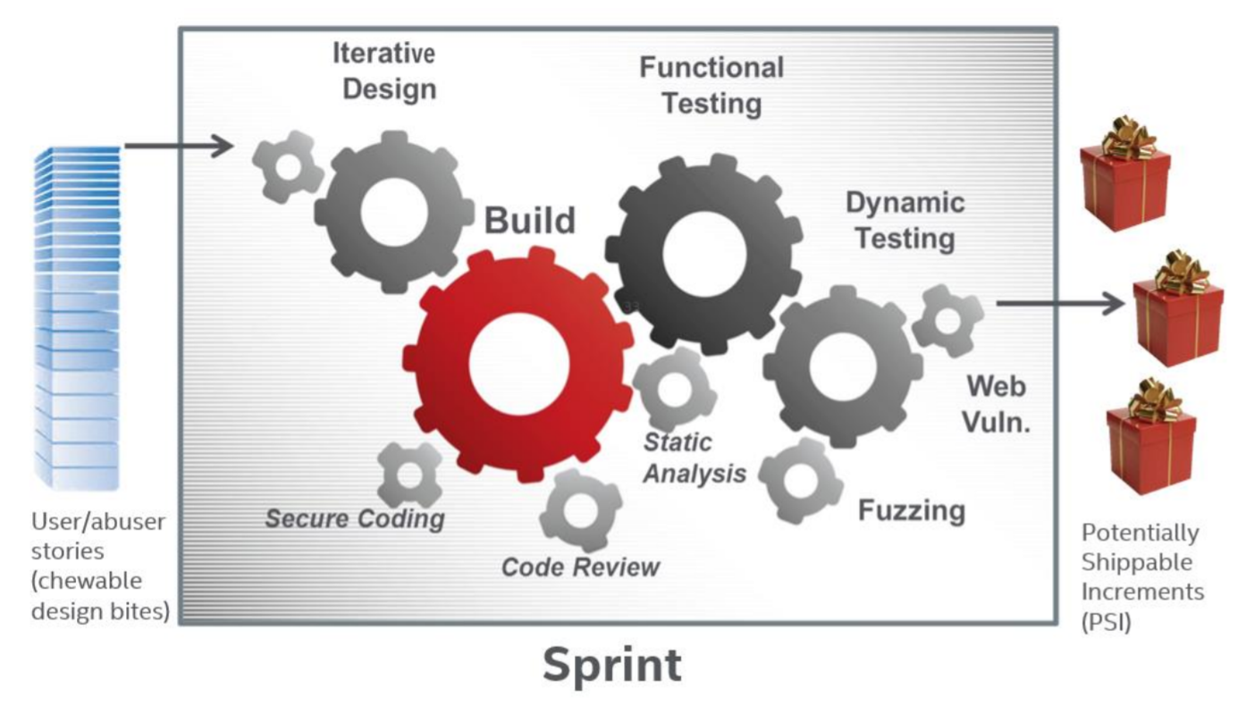
SDLC Introduction
SOFTWARE QUALITY CONFERENCE
PACIFIC NW
PNSQC ™
Notes:
= Software Security
Software security is the idea of developing software so that it continues to function correctly under malicious attacks of vulnerabilities. Security is necessary to provide integrity, authentication and availability as non-functional requirements.

Slide 6
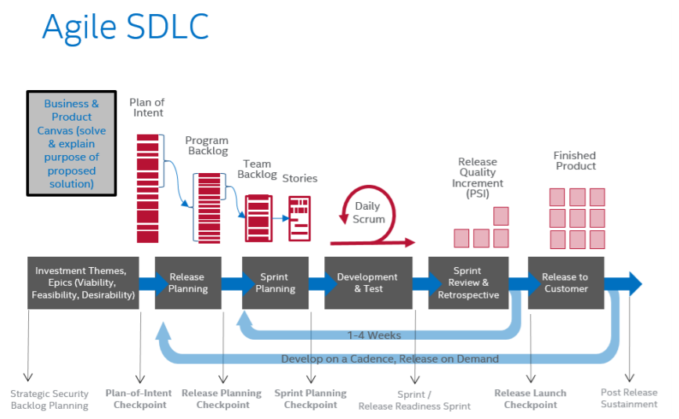
SDLC Introduction
SOFTWARE QUALITY CONFERENCE
PACIFIC NW
PNSQC ™
Notes:
= Agile SDLC
Any project that involves a change to the architecture of the product is required to go through a security architecture review. The proposed architectural changes are analyzed for security requirements, as well as analyzed within the whole of the architecture of the product for each change’s security implications. A threat model is created or updated. The output of this analysis will typically be the security requirements that must be folded into the design that will be implemented. An architecture review may be a discreet event or may be accomplished iteratively as the architecture progresses (Agile).
The Agile SDL requires that designs that contain security features or effects are reviewed to make sure that security requirements will be built correctly. The Security Architect signs off when the design meets expectations. All functional items, including security design elements, are included in the thorough functional test plan. Like architectural reviews, a design review may be a discreet event or may be accomplished iteratively when design work occurs (Agile).
In tandem with architecture and design reviews, privacy reviews are conducted. A Privacy Impact Assessment (PIA) is performed to determine if any additional privacy activities are required to protect personal data. Privacy reviews cover the whole lifecycle of personal data and often extend beyond the product collecting the data and include backend systems and infrastructure.

Slide 7
Key points and Overview of Content
SOFTWARE QUALITY CONFERENCE
PACIFIC NW
SDLC Introduction
PSMM
Concept
Requirements
Design
Implementation
Verification
Release
Response
Conclusions
PNSQC ™

Slide 8
PSMM
SOFTWARE QUALITY CONFERENCE
PACIFIC NW
= Multi-layered
= Measurement units
= Quantifies security maturity of a product's development
http://uploads.pnsqc.org/2015/papers/t-051_Rebelo_paper.pdf
PNSQC ™
Notes:
A Security Maturity Model applied to SDL is a multi-layered measurement approach that can be applied to any product to understand security practices. Is not different from other maturity models but having security-related practices as the focus.
The McAfee Product Security Maturity Model is how McAfee evaluates developing team's work and procedure related to implemented tasks, activities and findings before, during and after the development process. The McAfee's PSMM covers around 16 topics which are evaluated in all aspects related to secure development, since new initial requirements are defined, architecture and design of new changes are reviewed, the whole process is monitored, and final checks are executed
Security Definition of Done (DoD) / Security Requirements Plan
Security Architecture Review
Security Design Review
Threat Modeling
Security Testing
Static Analysis
Dynamic Analysis (Web Apps)
Fuzz Testing
Vulnerability Scan
Penetration Testing
Manual Code Review
Secure Coding Standards
Open Source and 3rd Party Libraries
License and Vendor Management
Privacy
Operating Environment

Slide 9
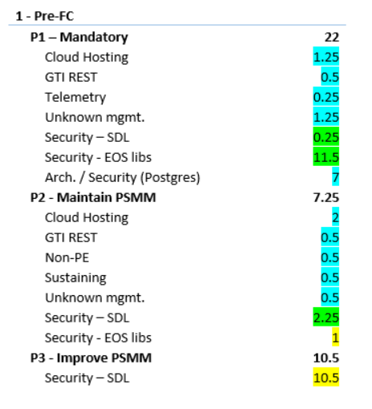
PSMM
SOFTWARE QUALITY CONFERENCE
PACIFIC NW
PNSQC ™

Slide 10
Key points and Overview of Content
SOFTWARE QUALITY CONFERENCE
PACIFIC NW
SDLC Introduction
PSMM
Concept
Requirements
Design
Implementation
Verification
Release
Response
Conclusions
PNSQC ™

Slide 11
Concept
SOFTWARE QUALITY CONFERENCE
PACIFIC NW
= Security Training
Each training increments should cover topics around:
Security Domain
Used Technology
Security Tools and Processes
PNSQC ™
Notes:
= Security Training
Training is a tool that avoid bugs up-front as they are not even created. Training should be considered a never-ending activity delivered to the team incrementally. Each training increments should cover topics around:
Security Domain: the team should be familiar with the security domain, including corporate practices around managing products on the same vertical.
Used Technology: the team should know language or framework specific hurdles around potential vulnerabilities when not implemented properly.
Security Tools and Processes: eventually the whole agile team should understand how to run security scans, how to test security communications, etc. Every task with changes to be required again should be documented for the rest of the team, and documentation on tasks should evolve when the tasks reoccurs.

Slide 12
Key points and Overview of Content
SOFTWARE QUALITY CONFERENCE
PACIFIC NW
SDLC Introduction
PSMM
Concept
Requirements
Design
Implementation
Verification
Release
Response
Conclusions
PNSQC ™

Slide 13
Requirements
SOFTWARE QUALITY CONFERENCE
PACIFIC NW
= DoD
Critical code should be reviewed by a senior or security SME
All code changes should be statically analyzed, and found defects addressed
New and modified interfaces should be dynamically tested using scanners and fuzzers.
New or modified dependencies should be reviewed.
PNSQC ™
Notes:
= DoD
The definition of done explicitly defines to the team members what needs to be completed before closing an assigned epic or story. From a security point of view:
Critical code should be reviewed by a senior or security SME (Subject Matter Expert)
All code changes should be statically analyzed, and found defects addressed
New and modified interfaces should be dynamically tested using scanners and fuzzers.
New or modified dependencies (such as 3rd party libraries) should be reviewed.

Slide 14
Requirements
SOFTWARE QUALITY CONFERENCE
PACIFIC NW
= EOL components
Each 3rd party component should be reviewed in search for vulnerabilities and signals of being out-of-maintenance.
The company keeps track of whitelisted and blacklisted projects so the analyzed does not need to be repeated across teams.
Factors while analyzing the health of a dependency are:
User base (downloads, discussion posts quantity)
Frequency of releases
Known and patched vulnerabilities
PNSQC ™
Notes:
= EOL components
Most products today rely on multiple third-party components. Each component should be reviewed in search for vulnerabilities and signals of being out-of-maintenance. The company keeps track of whitelisted and blacklisted projects so the analyzed does not need to be repeated across teams.
Factors while analyzing the health of a dependency are:
User base (downloads, discussion posts quantity)
Frequency of releases
Known and patched vulnerabilities

Slide 15
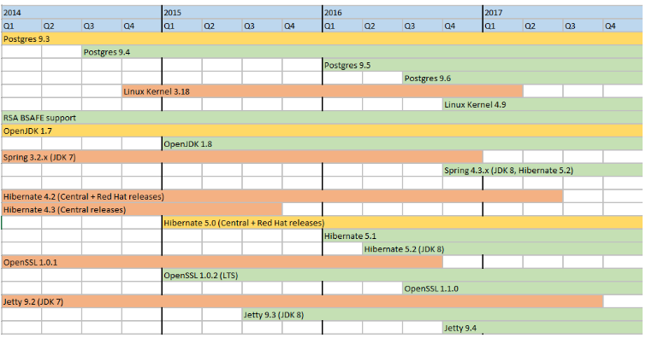
Requirements
SOFTWARE QUALITY CONFERENCE
PACIFIC NW
PNSQC ™

Slide 16
Requirements
SOFTWARE QUALITY CONFERENCE
PACIFIC NW
= SDL Kanban
During this phase a standard questionnaire is used to dimension the SDL work for the release, for instance:
Is the target release vehicle a major update or just contains minor maintenance changes?
It the product architecture changed?
Is there any change on dependencies?
Is any new PII information being handled at the product?
PNSQC ™
Notes:
= SDL Kanban
The security architect creates a storyboard or Kanban with all mandatory, required, and optional SDL activities. Those activities can be ordered by sprints, how they can be implemented, and ordered by importance and/or effort.
Once this is prioritized together by the team, it should be captured in the product backlog itself. During this phase a standard questionnaire is used to dimension the SDL work for the release, for instance:
Is the target release vehicle a major update or just contains minor maintenance changes?
It the product architecture changed?
Is there any change on dependencies?
Is any new PII information being handled at the product?

Slide 17
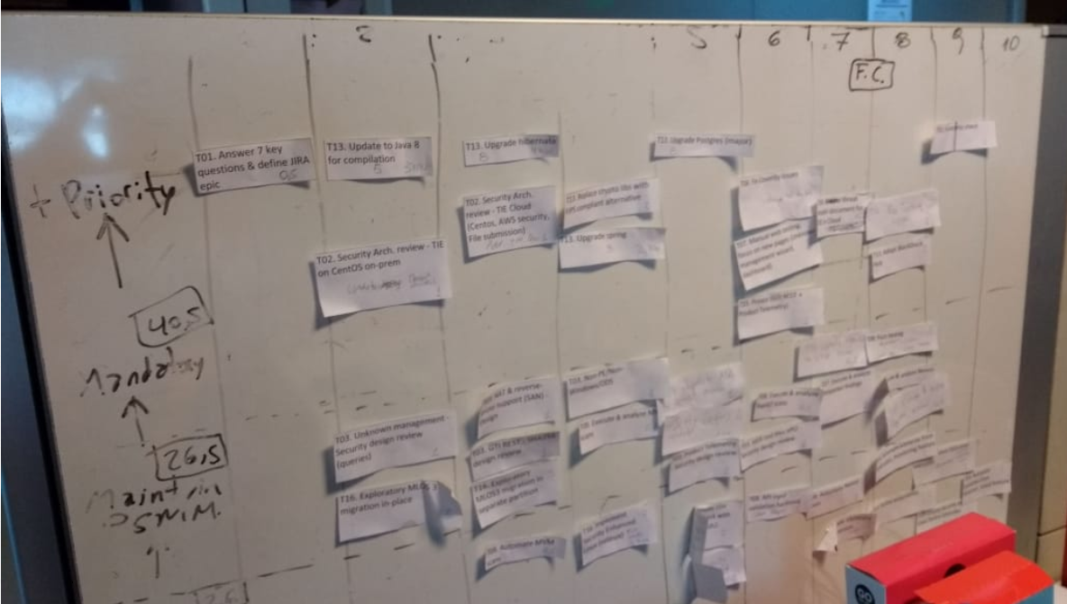
Requirements
SOFTWARE QUALITY CONFERENCE
PACIFIC NW
PNSQC ™

Slide 18
Requirements
SOFTWARE QUALITY CONFERENCE
PACIFIC NW
= PIA
Feature review from privacy point of view.
Detailed documentation of information being collected, persisted and ship to cloud-based services if that is the case.
Details about how long the information will be stored and documentation on how to delete them if required.
PNSQC ™
Notes:
= PIA
Feature review from privacy point of view. Detailed documentation of information being collected, persisted and ship to cloud-based services if that is the case. Also details about how long the information will be stored and documentation on how to delete them if required.

Slide 19
Key points and Overview of Content
SOFTWARE QUALITY CONFERENCE
PACIFIC NW
SDLC Introduction
PSMM
Concept
Requirements
Design
Implementation
Verification
Release
Response
Conclusions
PNSQC ™

Slide 20
Design
SOFTWARE QUALITY CONFERENCE
PACIFIC NW
= Security Plan
Documents targeted tasks after prioritizing and ranking requirements.
All tasks in scope are then added to the backlog thru user stories.
The security plan should include user stories towards maintaining or increasing the product security maturity level.
= Architecture and Design Security Analysis
Documents the product’s architecture.
Is then used to produce the Security Design Review and Threat Model.
Helps to identify possible attack vectors early in the product development lifecycle before design.
PNSQC ™
Notes:
= Security Plan
A security plan documents targeted tasks (also non-targeted ones) after prioritizing and ranking requirements. All tasks in scope are then added to the backlog thru user stories. The security plan should include user stories towards maintaining or increasing the product security maturity level.
= Architecture and Design Security Analysis
A security architecture review fully documents the product’s architecture. This architecture review is then used to produce the Security Design Review and Threat Model. These help to identify possible attack vectors early in the product development lifecycle before design. The security architecture review is intended to be a starting point to build security into the product.

Slide 21
Design
SOFTWARE QUALITY CONFERENCE
PACIFIC NW
= Threat Modeling
Uses the security architecture to identify all possible attack vectors.
Used to address potentials weaknesses and create their countermeasures or mitigate the effects.
Helps to prioritize the threat/attack vector based on risks and business requirements.
STRIDE can be used to identify new threats answering typical questions around each component.
PNSQC ™
Notes:
= Threat Modeling
A threat model uses the security architecture to identify all possible attack vectors. The attack vectors that exposer areas of potential security exploitation weaknesses (a.k.a. vulnerabilities) are then addressed by defining countermeasures to prevent, or mitigate the effects of, threats to the system early in the design phase. Threat models are used to prioritize the threat/attack vector based on risk and business requirements.
To identify those weaknesses, many methodologies can be applied, among them STRIDE is widely used for this purpose.
STRIDE means Spoofing, Tampering, Repudiation, Information Disclosure, Denial of Service and Elevation of Privilege. Can be used to identify new threats answering typical questions around each component (or new integration).

Slide 22
Key points and Overview of Content
SOFTWARE QUALITY CONFERENCE
PACIFIC NW
SDLC Introduction
PSMM
Concept
Requirements
Design
Implementation
Verification
Release
Response
Conclusions
PNSQC ™

Slide 23
Implementation
SOFTWARE QUALITY CONFERENCE
PACIFIC NW
= Secure Coding Standards
Checkstyle
Findbug
PMD
= Static Analysis
Coverity
Checkmarx
Klockwork
= Threat Modeling (updates)
= New Tools Evaluation
PNSQC ™
Notes:
= Secure Coding Standards
Ensure secure coding standards and best practices are used throughout the development of the product.
One way to achieve that is trainings the development team and adding plug-ins with custom information to the development IDE.
{Tools}
= Static Analysis
Static analysis is a method of examining software for vulnerabilities at compile and/or build-time, reporting potential defects in source code. The analysis searches the code for known weaknesses such as buffer overflows, null pointer exceptions, among others.
{Tools}
= Threat Modeling
On this phase we recommend looking again the Threat Model in order to find new changes, missing vectors due to design changes.
We found that a threat model update on this phase also can be useful to make because architecture changes can be in place due to unexpected conditions or requirement changes.
= New Tools Evaluation
In a mature development team, multiple tools can be integrated during the development pipeline. All tools already implemented in the CI/CD process helps at the beginning to get new findings and then to keep the quality code standards.
Every day new tools are created and shared into the market. Testing or implementing those tools helps not only to get new findings

Slide 24
Key points and Overview of Content
SOFTWARE QUALITY CONFERENCE
PACIFIC NW
SDLC Introduction
PSMM
Concept
Requirements
Design
Implementation
Verification
Release
Response
Conclusions
PNSQC ™

Slide 25
Verification
SOFTWARE QUALITY CONFERENCE
PACIFIC NW
= Dynamic Analysis
ZAP Proxy
Netsparker
w3af
BurpSuite
= Interactive Analysis
Combination between dynamic and static analysis technologies.
Analyzes leverages information from inside the running application
Runtime requests, data flow, control flow, libraries, and connections
PNSQC ™
Notes:
= Dynamic Analysis
Dynamic analysis tools find vulnerabilities in the binary executables and other runtimes, like Web applications at run-time, by executing the code over multiple test cases, reporting actual defects.
Most dynamic solutions test only exposed HTTP and HTML interfaces of Web-enabled applications, they’re also called Web Application Scanning.
{Tools}
= Interactive Analysis
Interactive analysis is a different form to test your application security that stems from a combination between dynamic and static analysis technologies. This approach analyzes leverages information from inside the running application, including runtime requests, data flow, control flow, libraries, and connections, to find vulnerabilities.

Slide 26
Verification
SOFTWARE QUALITY CONFERENCE
PACIFIC NW
= Fuzz Testing
Subset of dynamic analysis.
Finds vulnerabilities and system crashes in the running binary executables by probing all inputs, network protocols, and file formats with intentionally invalid data.
= Manual Code Review
Security-focused manual code reviews involve humans to search for and find vulnerabilities and weaknesses in the source code.
Github Code review tool
CodeCollaborator, SVN
PNSQC ™
Notes:
= Fuzz Testing
Fuzz testing or “fuzzing” is a subset of dynamic analysis. It finds vulnerabilities and system crashes in the running binary executables by probing all inputs, network protocols, and file formats with intentionally invalid data. It permutates the packet boundaries with illegal formats to see if the running program will trigger an error condition or fault. These error conditions can lead to exploitable vulnerabilities.
= Manual Code Review
Security-focused manual code reviews involve humans to search for and find vulnerabilities and weaknesses in the source code.
Code review it’s a fundamental step when a developer wants to add his own code to the main repository. Github has his own Code Review tool and it’s widely used cross all development teams. CodeCollaborator helps to accomplish the objective and has the capability to integrate with other versioning software like SVN.

Slide 27
Vulnerability Scan
SOFTWARE QUALITY CONFERENCE
PACIFIC NW
= Vulnerability Scan
OpenVAS
Nessus
Nexpose
= Penetration Test
Custom scripts should be implemented and integrated with common tools and frameworks
Nmap
Metasploit
Powershell Empire
PNSQC ™
Notes:
= Vulnerability Scan
A vulnerability scanner is a tool used to find known vulnerabilities and exposures in a binary executable and the environment to which it is deployed and runs.
This stage where most of the tools can be found. The most used ones are based on environment scanner like OpenVAS by OWASP, Nessus and Nexpose.
= Penetration Test
Pen testing requires sophisticated use of tools by human analysts to find and then prove vulnerabilities in executables and the environment in which they run.
On this stage mostly, custom scripts should be implemented and integrated with common tools and frameworks like Nmap, Metasploit.

Slide 28
Key points and Overview of Content
SOFTWARE QUALITY CONFERENCE
PACIFIC NW
SDLC Introduction
PSMM
Concept
Requirements
Design
Implementation
Verification
Release
Response
Conclusions
PNSQC ™

Slide 29
Release
SOFTWARE QUALITY CONFERENCE
PACIFIC NW
= Conduct Final Security Review
Summarize all security activities
Improve all security controls made during the development phase.
= Retrospective
New tools can be discussed
How to track security tasks
Know what was useless during the process
What can be improved or modified
What can be a good thing to start doing.
PNSQC ™
Notes:
= Conduct Final Security Review
After the development a testing conduct a final security review helps to summarize and improve all security controls made during the development phase.
= Retrospective
A retrospective review, from a security related perspective is useful. During this meeting, new tools can be discussed, how to track security tasks, know what was useless during the process, what can be improved or modified, what can be a good thing to start doing.

Slide 30
Key points and Overview of Content
SOFTWARE QUALITY CONFERENCE
PACIFIC NW
SDLC Introduction
PSMM
Concept
Requirements
Design
Implementation
Verification
Release
Response
Conclusions
PNSQC ™

Slide 31
Response
SOFTWARE QUALITY CONFERENCE
PACIFIC NW
= PSIRT
Reacts after a new vulnerability disclosure.
Document how those vulnerabilities affects the product and how to mitigate them.
Security Bulletin can be created.
= Post-Release Certifications
FIPS
Common Criteria
FedRAMP
PNSQC ™
Notes:
= PSIRT
It’s very common that new vulnerabilities appear once the product is running in production. You can either document the vulnerabilities and their impact, and/or implement changes fixing the vulnerability,
A Security Bulletin is a document where the vulnerabilities are described and analyzed by the security experts. In this document information related to the vulnerabilities such as vulnerability ID, widely known as CVE, their impact on the software using an attack vector known as CVSS, and if it’s a workaround or software fix update.
= Post-Release Certifications
We have undergone multiple independently product certifications, as they are required by many verticals in the financial and aerospace industries.
{FIPS, CC, FedRamp}

Slide 32
Key points and Overview of Content
SOFTWARE QUALITY CONFERENCE
PACIFIC NW
SDLC Introduction
PSMM
Concept
Requirements
Design
Implementation
Verification
Release
Response
Conclusions
PNSQC ™

Slide 33
Conclusions
SOFTWARE QUALITY CONFERENCE
PACIFIC NW
The impact on having automation in place for defect identification and testing APIs and communication channel cryptography cannot be highlighted enough.
Removing security issues in the code is cheap when they are identified earlier in the development process.
Quick re-test of cryptography over communication channels allow the usual fine-tuning on default algorithms and key sizes when undergoing compliance certifications such as Common Criteria and FIPS.
The identification and tracking of EOL components helps planning of current and future releases, allowing to establish what not will be updated and how it would be mitigated if required up-front.
Having an agile mindset towards the application of DoD and the team training has allowed teams to harden components and add expertise incrementally and globally.
PNSQC ™

Slide 34
Q & A
THANK YOU!

Slide 35
Contacts
SOFTWARE QUALITY CONFERENCE
PACIFIC NW
Nicolas Guini is a Software Security Architect at McAfee Argentina. Nicolas has a Computing Engineer Degree where worked with Security Tools for pentesting, a Specialization on Computer Security and two Ethical Hacking Certifications. Lecturer at OWASP and local universities.
LinkedIn: https://ar.linkedin.com/in/guininicolas
Andres More is a Software Product Architect at McAfee Argentina. Andres has a CS degree where implemented mandatory security control at Linux’s network stack, and a MSc in High Performance Computing where developed infrastructure to support performance optimization. Lecturer at OWASP and postgraduate courses in security at a local military institution.
LinkedIn: https://www.linkedin.com/in/andresmore/
PNSQC ™

